Slide 1
Introduction to Social Media Analytics (Lec 9)
Hao PENG
Department of Data Science
City University of Hong Kong
https://haoopeng.github.io/

Slide 2
Topics for this week
Network Science
Background
Characteristics of Social Networks
Short average distance
High clustering coefficient
Power-law degree distribution
Social influence/hubs
Strong and weak ties
Community structure
Applications
Community detection
Cascade prediction
Information diffusion
Network visualization

Slide 3
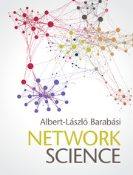
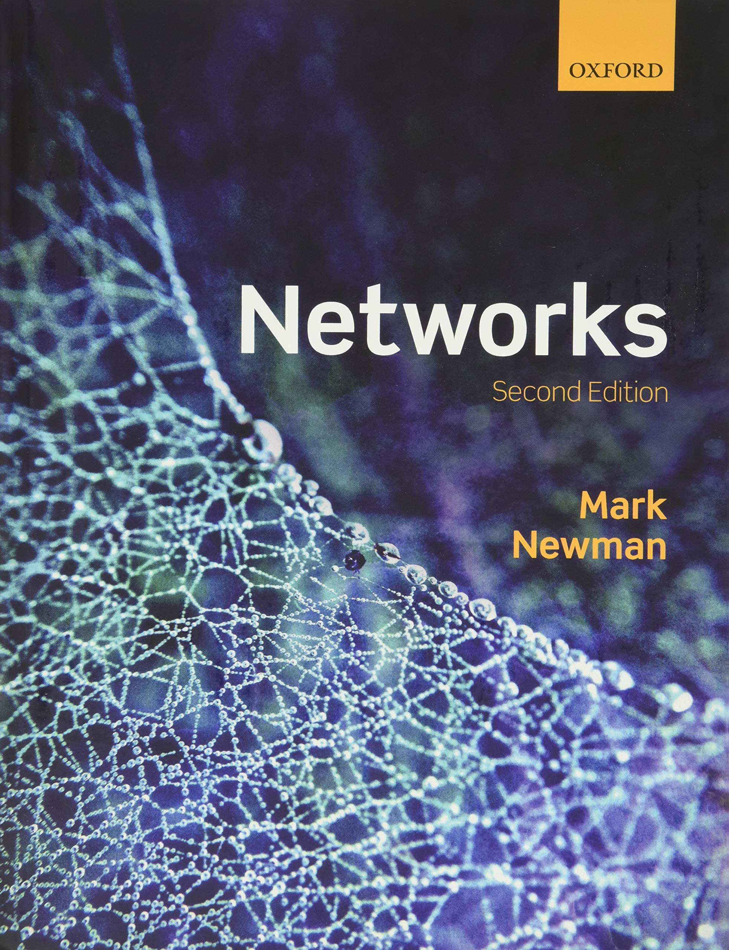
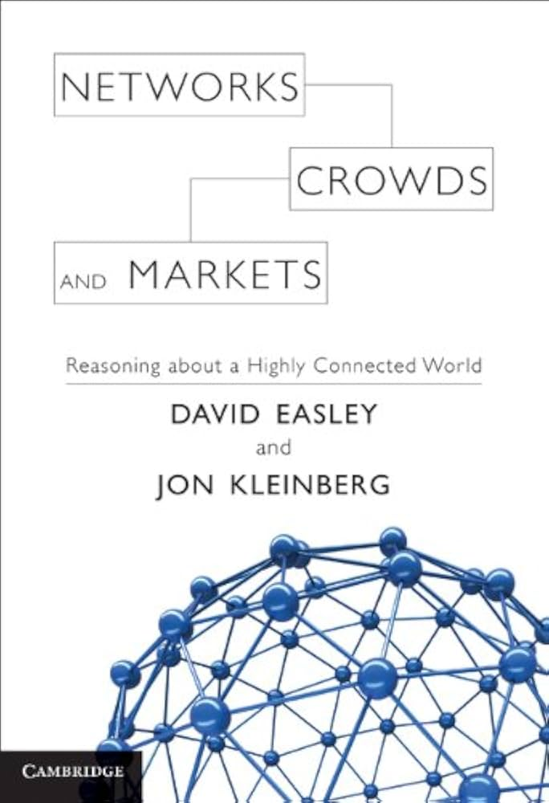
Network Science
In the domain of network science, researchers don’t study networks in the abstract, but instead, they study numerous real-world complex networks to understand their properties, dynamics, and behaviors.
Examples include social networks, transportation networks, WWW, gene regulatory networks, citation networks, collaboration networks, etc.
Key scholars: Mark Newman, Albert-László Barabási, Jon Kleinberg, Duncan Watts...
Notes:
Network science is a relatively new discipline that has only been able to blossom because of computer technologies. With computers, scientists are able analyze large-scale networks such as the World Wide Web which has approximately 500 billion nodes. Due to their size, such structures tend to be studied from a statistical perspective.

Slide 4
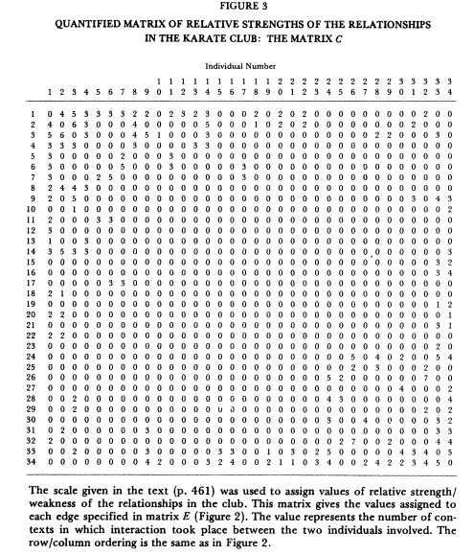
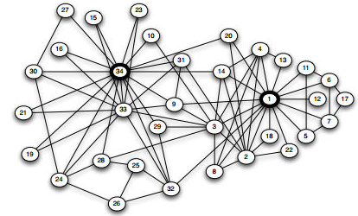
Networks before ``Big Data”
Friendship network in a karate club (Zachary 1977)
Adjacency Matrix of tie strength in karate club network

Slide 5
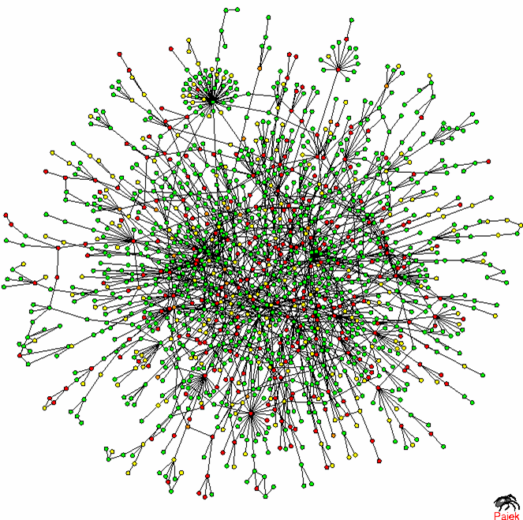
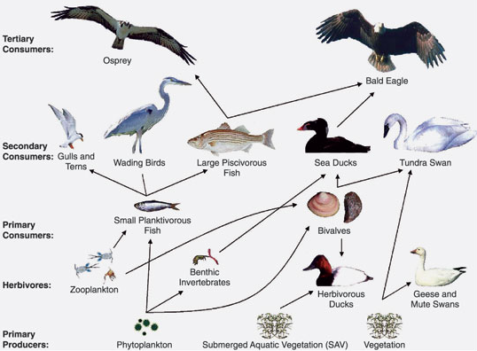
Biological Networks
Protein-protein interactions (Jeong)
Chesapeake Bay Waterbird Food Web

Slide 6
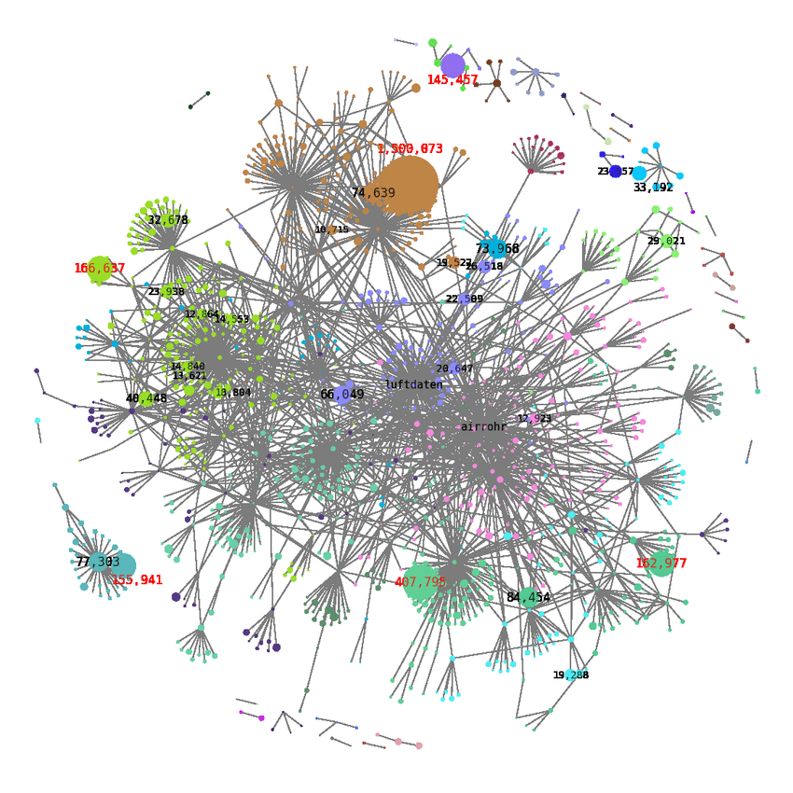
Networks after ``Big Data”
Retweet network (Hamm 2021)
DOI: 10.1145/3411764.3445667

Slide 7
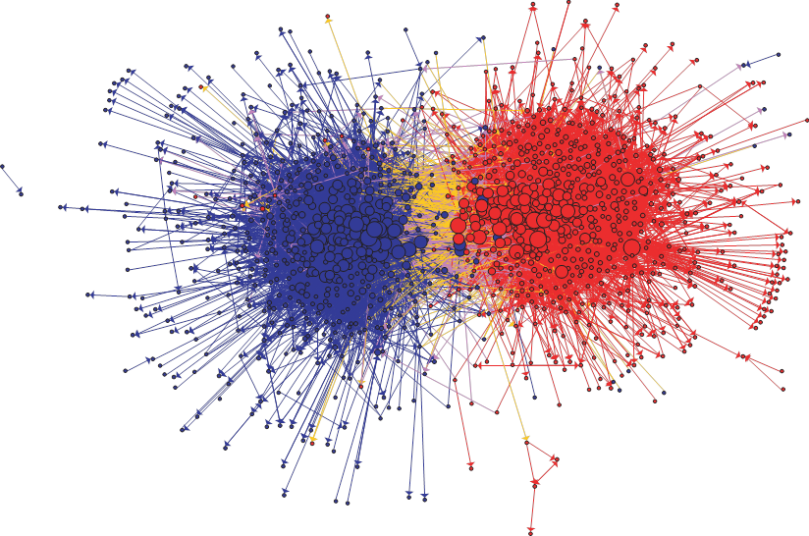
Information Networks
Communication between left-wing and right-wing political blogs (Adamic and Glance)

Slide 8
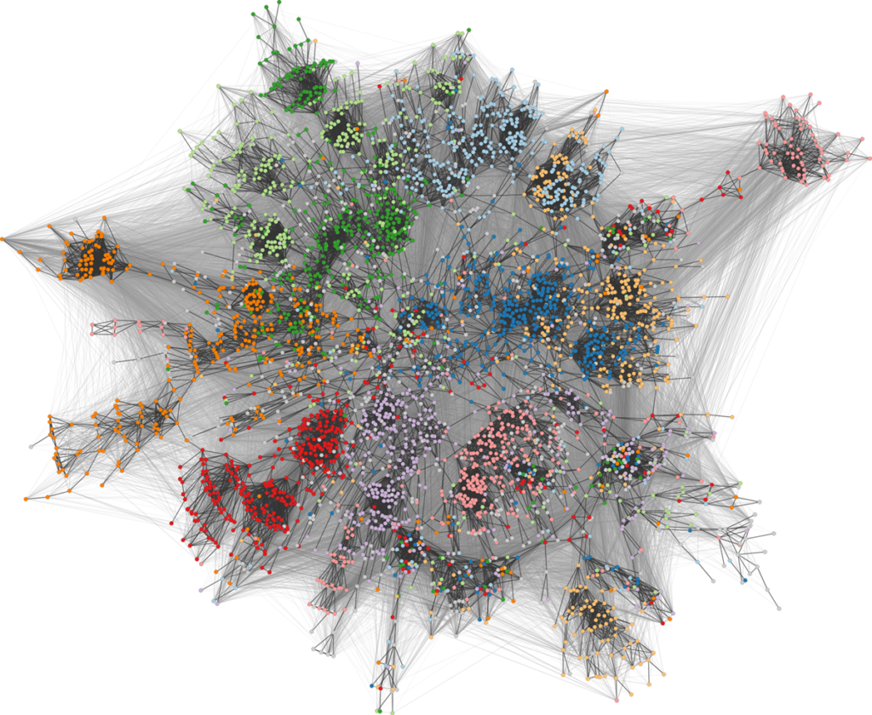
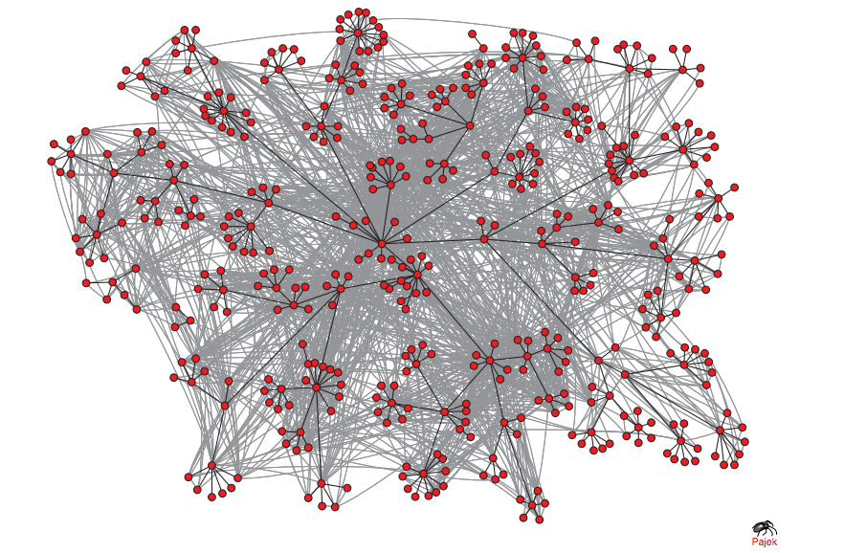
Social Networks
E-mail communication network among 436 HP employees
Facebook network of university students (color shows dormitory)

Slide 9
And more…
This is why we need statistical models and algorithms to study networks!
Trade networks
Financial networks
Citation networks
Collaboration networks
Mentorship networks
Epidemic networks
…
Free online: https://www.cs.cornell.edu/home/kleinber/networks-book/

Slide 10
Network definition & vocabulary
A representation of connections among a set of items.
Items are called nodes (vertices)
Connections are called edges (or link or ties)
G
A
Different types of networks:
Undirected, directed
Unweighted, weighted
Connected, disconnected
B
C
F
D
Edge
E
Node

Slide 11
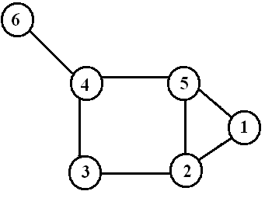
Degree of nodes
Number of edges incident on a node
The degree of node i: d(i)
d(6) = 1
d(4) = 3
d(5) = 3
d(1) = 2
d(3) = 2
d(2) = 3

Slide 12
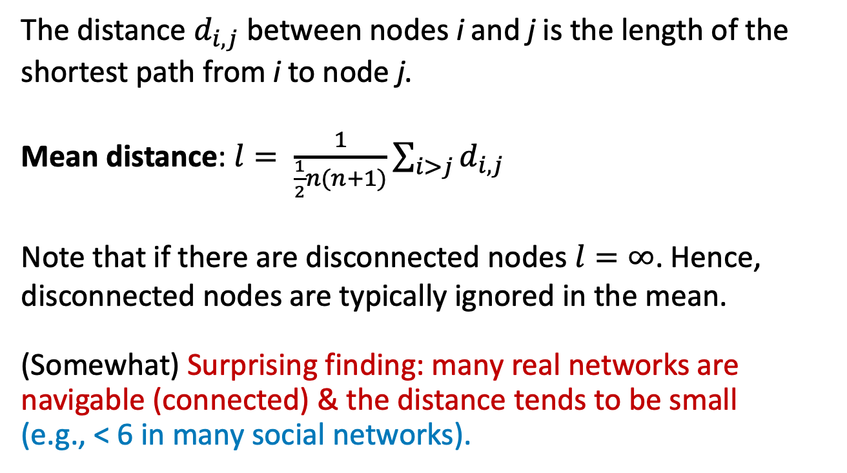
Average distance
The distance $d_{i,j}$ between nodes i and j is the length of the shortest path from i to node j.
Mean distance: $l= \frac{1}{\frac{1}{2}n(n+1)}\sum_{i>j}{d_{i,j}}$
Note that if there are disconnected nodes $l=∞$. Hence, disconnected nodes are typically ignored in the mean.
(Somewhat) Surprising finding: many real networks are navigable (connected) & the distance tends to be small
(e.g., < 6 in many social networks).

Slide 13
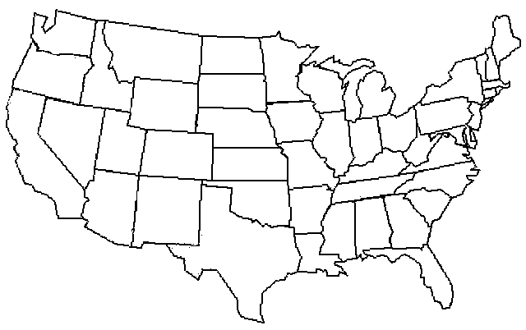
The small-world experiment
On average, it took only six steps to reach the target.
Fig: Baruch Barzel
J. Travers and S. Milgram, Sociometry 32,425–443 (1969)
https://en.wikipedia.org/wiki/Small-world_experiment

Slide 14
Six-degree replicated
Peter Sheridan Dodds, Roby Muhamad, and Duncan Watts replicated Milgram’s experiment with email:
18 targets in 13 countries
60,000 participants from 166 countries
“Targets included a professor at an Ivy League university, an archival inspector in Estonia, a technology consultant in India, a policeman in Australia, and a veterinarian in the Norwegian army.”
Average: 7 steps

Slide 15
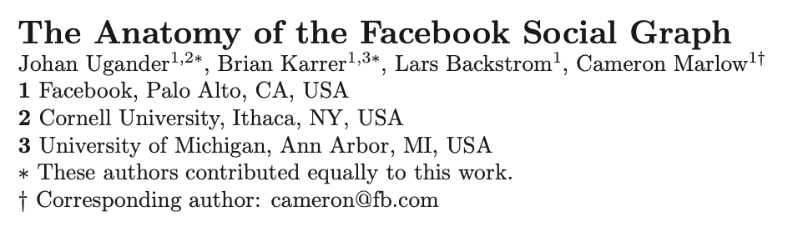
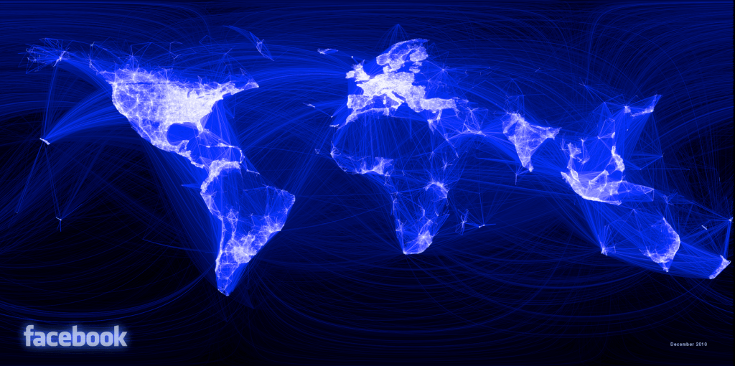
Even shorter distance on FB
Average distance on FB: 4.74 (world-wide) and 3.57 (U.S.)

Slide 16
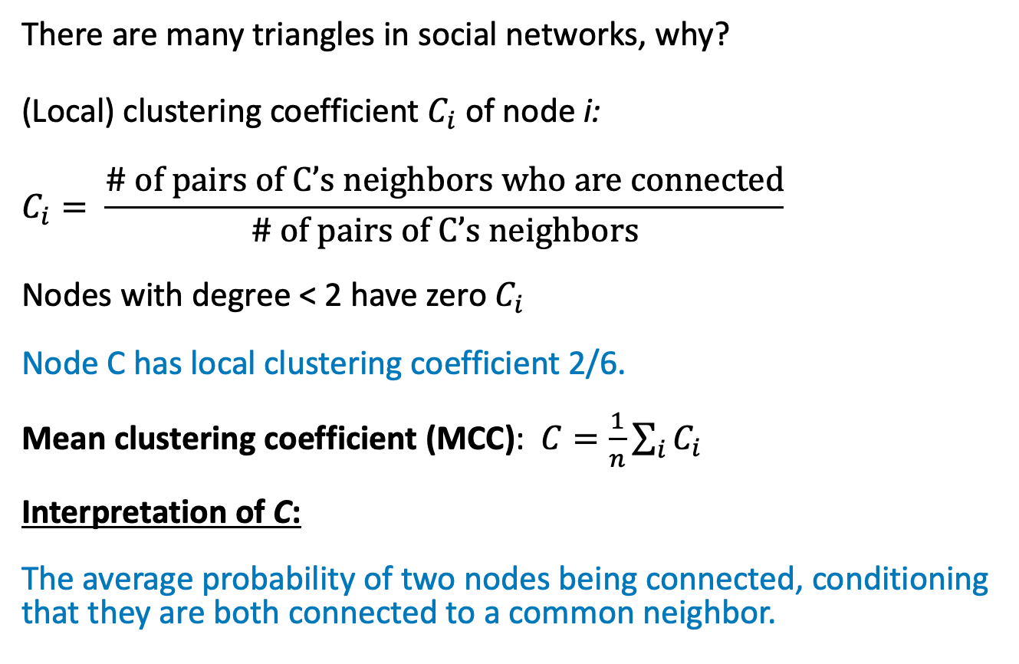
Clustering (transitivity)
There are many triangles in social networks, why?
(Local) clustering coefficient $C_{i}$of node i:
$$C_{i}= \frac{\text{\# }\text{of} \text{pairs} \text{of} \text{C}\text{’}\text{s} \text{neighbors} \text{who} \text{are} \text{connected}}{\text{\# }\text{of} \text{pairs} \text{of} \text{C}\text{’}\text{s} \text{neighbors}}$$
Nodes with degree < 2 have zero $C_{i}$
Node C has local clustering coefficient 2/6.
Mean clustering coefficient (MCC): $C=\frac{1}{n}\sum_{i}{C_{i}}$
Interpretation of C:
The average probability of two nodes being connected, conditioning that they are both connected to a common neighbor.
A
B
C
F
E

Slide 17
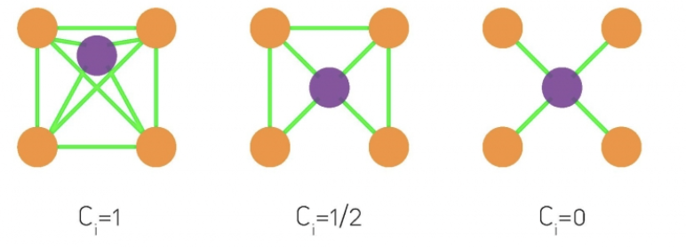
High clustering coefficient
In real-world social networks, the clustering coefficient tends to be very high — my friends tend to be friends with each other.
Example:
Facebook friendship network
Clustering coefficient: 0.3-0.5 or even higher
Film actors from IMDB
Clustering coefficient: 0.79

Slide 18
Properties of real social networks
Short average distance
High clustering coefficient
Power-law degree distribution
Homophily, (dis)assortative mixing
Social influence and hubs
Strong ties and weak ties
Community structure
And many more….
Notes:
To name a few, which we will learn in more details later.

Slide 19
Models of network formation
Erdős–Rényi model (ER random networks)
Barabási–Albert model (scale-free networks)
Watts–Strogatz model (small-world networks)
Many others…
These network generation models help us understand how the real-world networks come into current shape.

Slide 20
Random graph (ER model)
p = 0.0 ; k = 0
N = 12
N nodes
Each pair of nodes has a probability p of being connected
Average degree, k = pN(N-1)/N ≈ pN
The network undergoes a phase transition in connectivity when the average degree reaches 1.
When k < 1, it is almost disconnected.
p = 0.09 ; k = 1
p = 1.0 ; k = 11
Erdős and Renyi (1959)
Notes:
First thing to understand a social network is why it is connected (or why is everybody connected to everybody else).

Slide 21
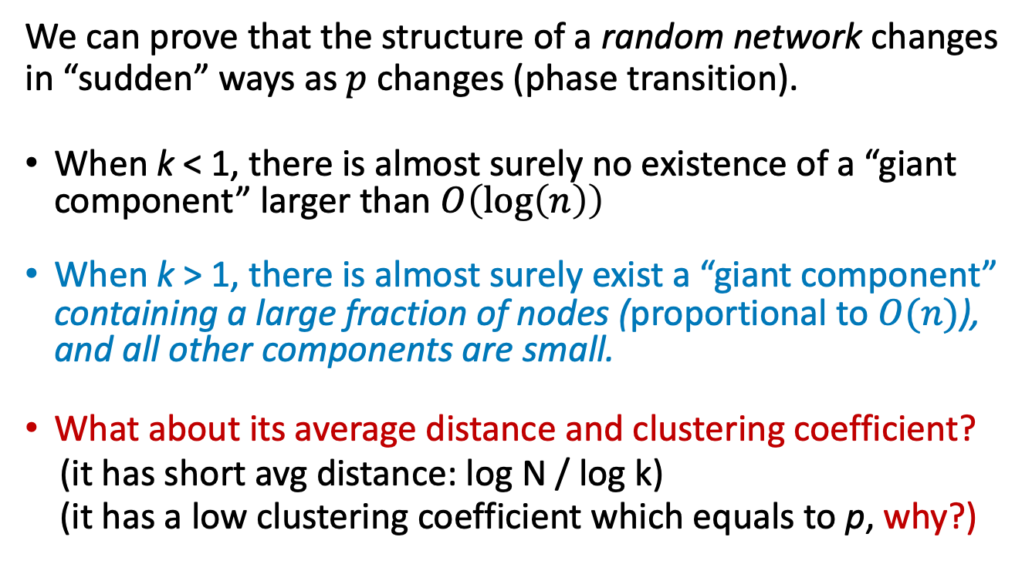
Random graph phase transition
We can prove that the structure of a random network changes in “sudden” ways as $p$ changes (phase transition).
When k < 1, there is almost surely no existence of a “giant component” larger than $O\left(\log\left(n\right)\right)$
When k > 1, there is almost surely exist a “giant component” containing a large fraction of nodes (proportional to $O(n)$), and all other components are small.
What about its average distance and clustering coefficient?
(it has short avg distance: log N / log k)
(it has a low clustering coefficient which equals to p, why?)
Avg. degree: k =pN=2M/N ==> p=2M/N²; p is close to 0 when N is large

Slide 22
Properties of the ER model
The Erdős–Rényi (random graph) model is easy to study mathematically. We understand many of its properties.
Yet, random graphs are still very different from real networks:
Low clustering coefficient (→ 0 as n gets larger)
Poisson degree distribution
No super-star nodes
No community structure
No homophily / (dis)assortative in degree
Except, it has short average distance
Overall, not very useful to model real social networks.

Slide 23
High clustering in social networks
Example:
Film actors from IMDB
Clustering coeff.: 0.79
Random graph with the same number of N nodes and M links
Clustering coeff.: 0.00027 (equals to p in the ER model)
avg. degree: k =pN=2M/N
==> p=2M/N², close to 0 when N is large
Can we design a network generation model (other than the ER graph) to have both (i) short avg distance (ii) high clustering?

Slide 24
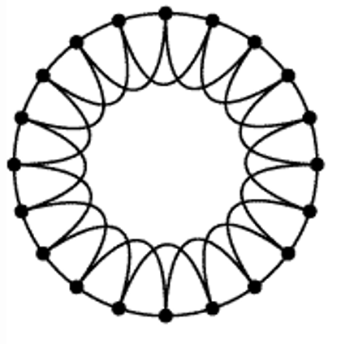
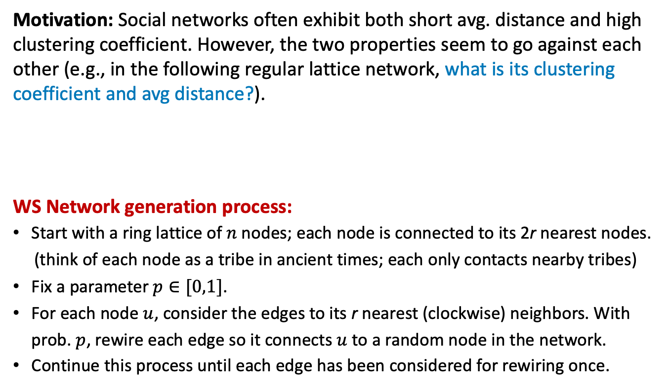
Watts–Strogatz model
Motivation: Social networks often exhibit both short avg. distance and high clustering coefficient. However, the two properties seem to go against each other (e.g., in the following regular lattice network, what is its clustering coefficient and avg distance?).
WS Network generation process:
Start with a ring lattice of $n$nodes; each node is connected to its 2r nearest nodes.
(think of each node as a tribe in ancient times; each only contacts nearby tribes)
Fix a parameter $p∈[0,1]$.
For each node $u$, consider the edges to its r nearest (clockwise) neighbors. With prob. $p$, rewire each edge so it connects $u$ to a random node in the network.
Continue this process until each edge has been considered for rewiring once.
Notes:
Clustering coeff: 0.5 for each node.

Slide 25
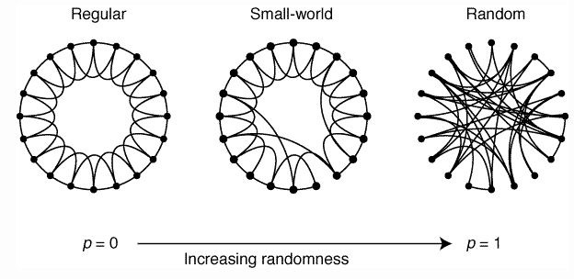
WS model (Small-world networks)
What is the mean distance and clustering coefficient for different $p$?
Watts and Strogatz. Nature, 1998.

Slide 26
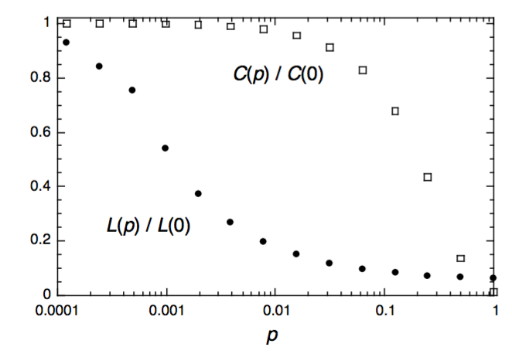
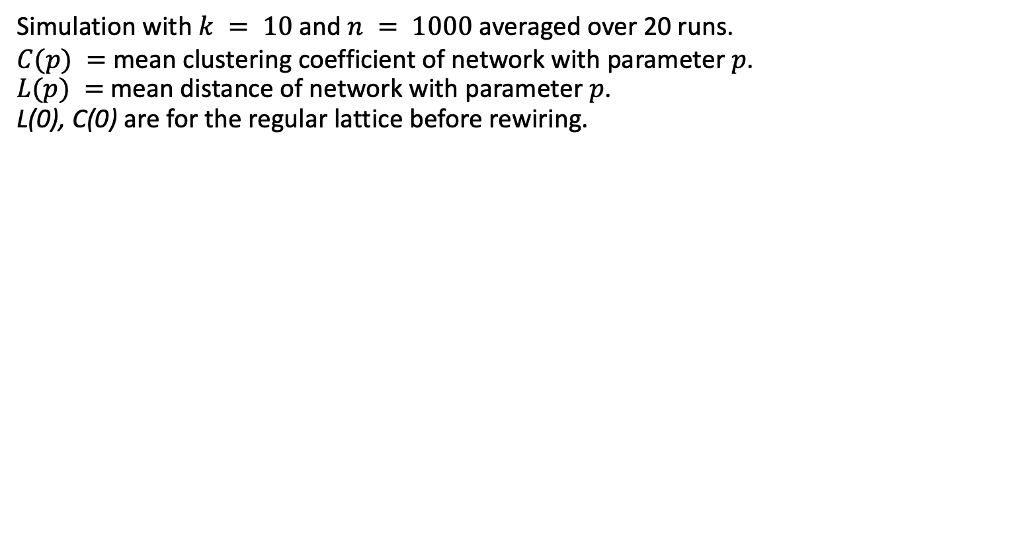
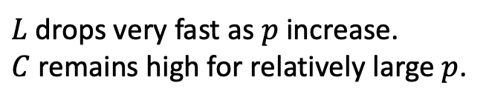
Model simulation
Simulation with $k = 10$and $n = 1000$averaged over 20 runs.
$C(p) =$mean clustering coefficient of network with parameter $p$.
$L(p) =$mean distance of network with parameter $p$.
L(0), C(0) are for the regular lattice before rewiring.
$L$ drops very fast as $p$ increase. $C$remains high for relatively large $p$.
This simple model can reproduce certain features of social networks.
But it has fixed degree for all nodes!
What about the degree distribution in ER random networks?
Watts and Strogatz. Nature, 1998.
Notes:
Uniform degree distribution

Slide 27
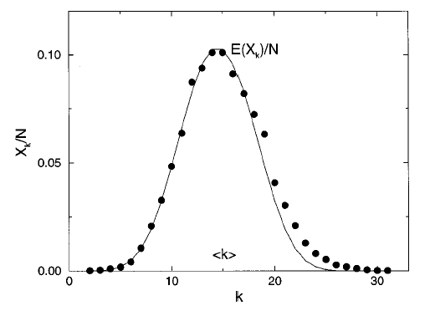
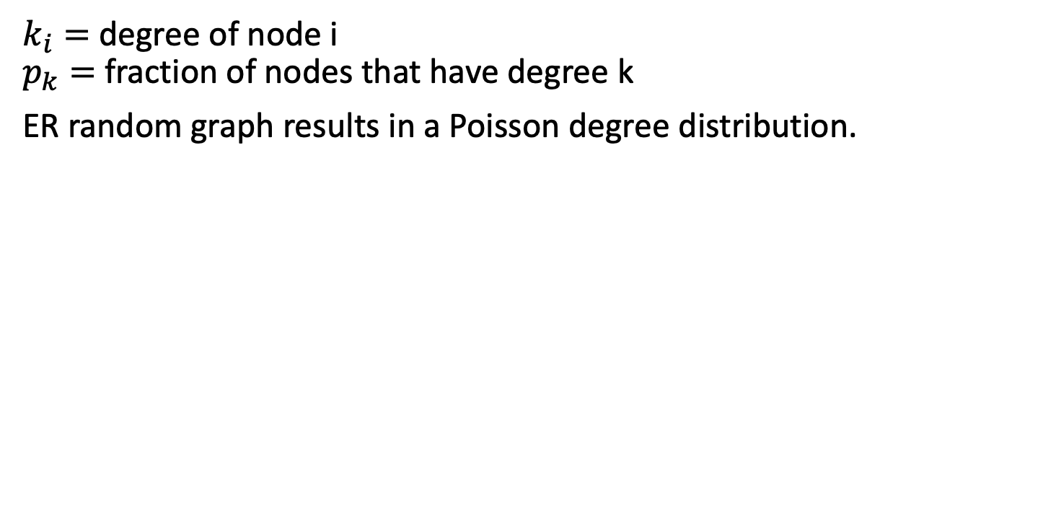
Poisson degree dist. in ER graphs
$k_{i}=$degree of node i
$p_{k}=$fraction of nodes that have degree k
ER random graph results in a Poisson degree distribution.
Degree distribution of a random graph,
with N = 10,000; p = 0.0015; k = 15.
(Curve is a Poisson curve.)
How many nodes in this ER network have > 30 connections to others?
What about the degree distribution in real social networks?

Slide 28
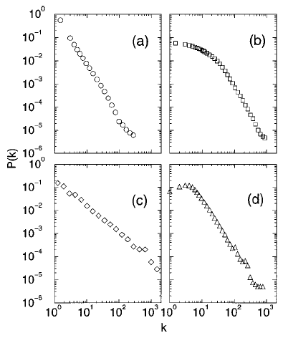
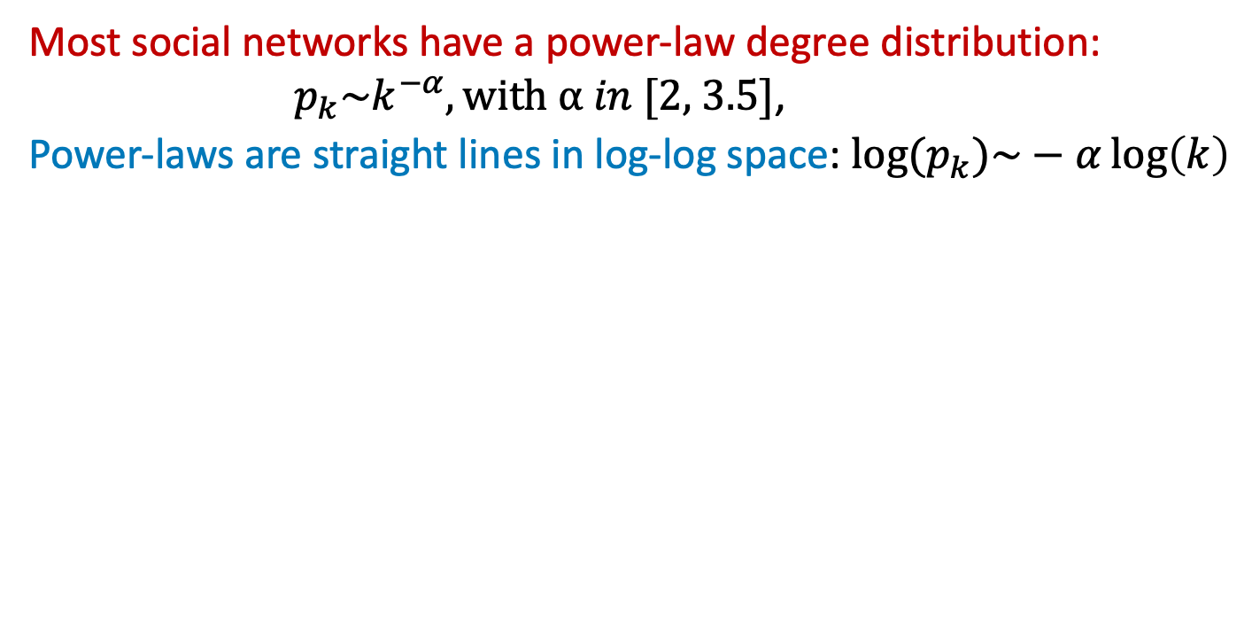
Power-law degree distribution
Most social networks have a power-law degree distribution: $p_{k}\sim k^{−α}, with α in [2\text{, 3.5}]$,
Power-laws are straight lines in log-log space: ${log⁡(p}_{k})\sim −α\log\left(k\right)$
Power laws in real networks:
(a) WWW hyperlinks
(b) co-starring in movies
(c) co-authorship of physicists
(d) co-authorship of neuroscientists
This means that there exists many “super-star” nodes in real networks! (missing in both ER & SW networks)

Slide 29
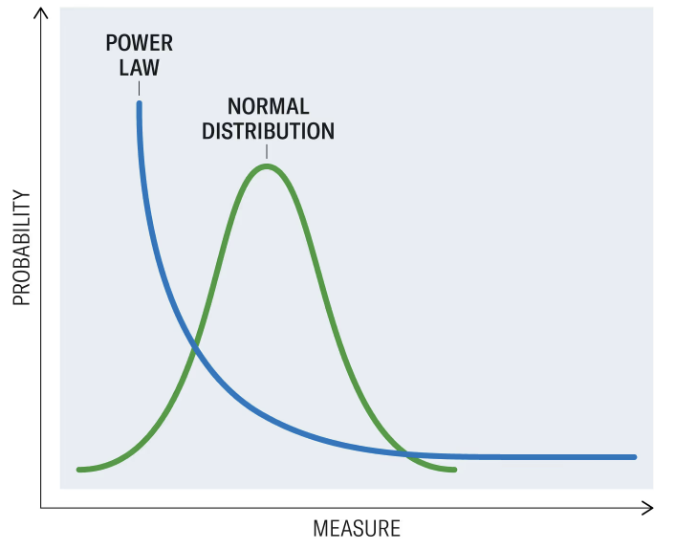
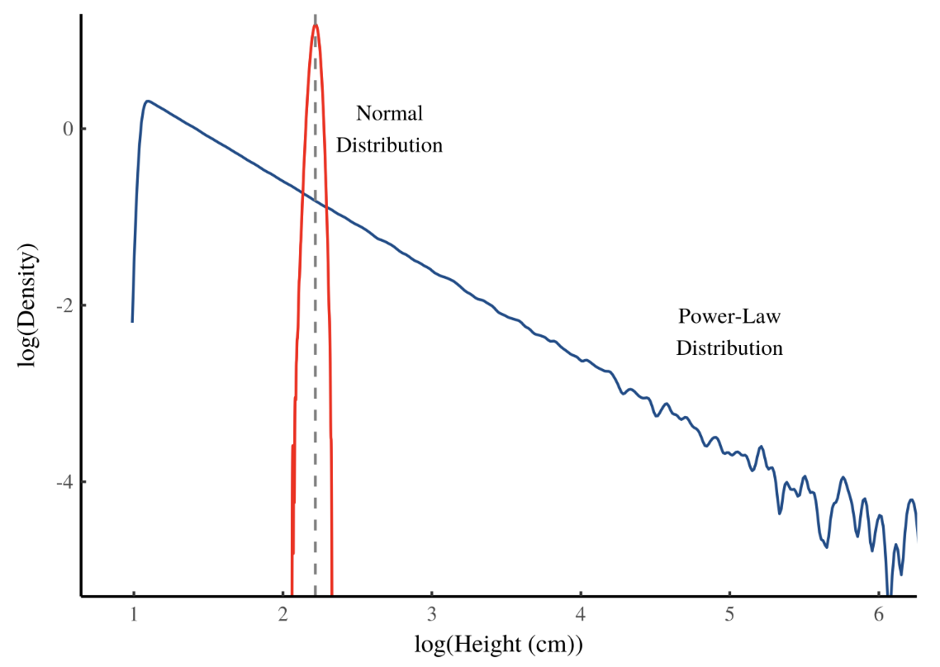
Power-law distribution
A statistical phenomenon where a small num. of items occupy a large fraction of outcomes (wealth, popularity, success, etc.).
It is perhaps the most well-know distribution in social & economic sciences.
Also known as the “80/20 rule”, “long-tail / scale-free distribution”:
log(Measure)
How can we design a network generation model to produce the power-law degree distribution?

Slide 30
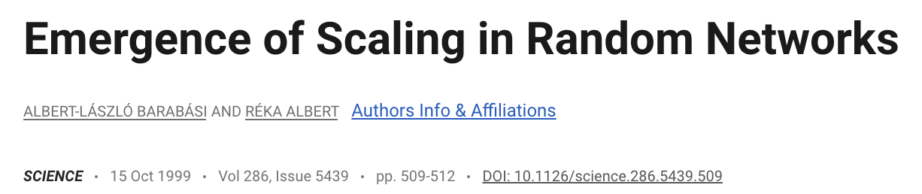
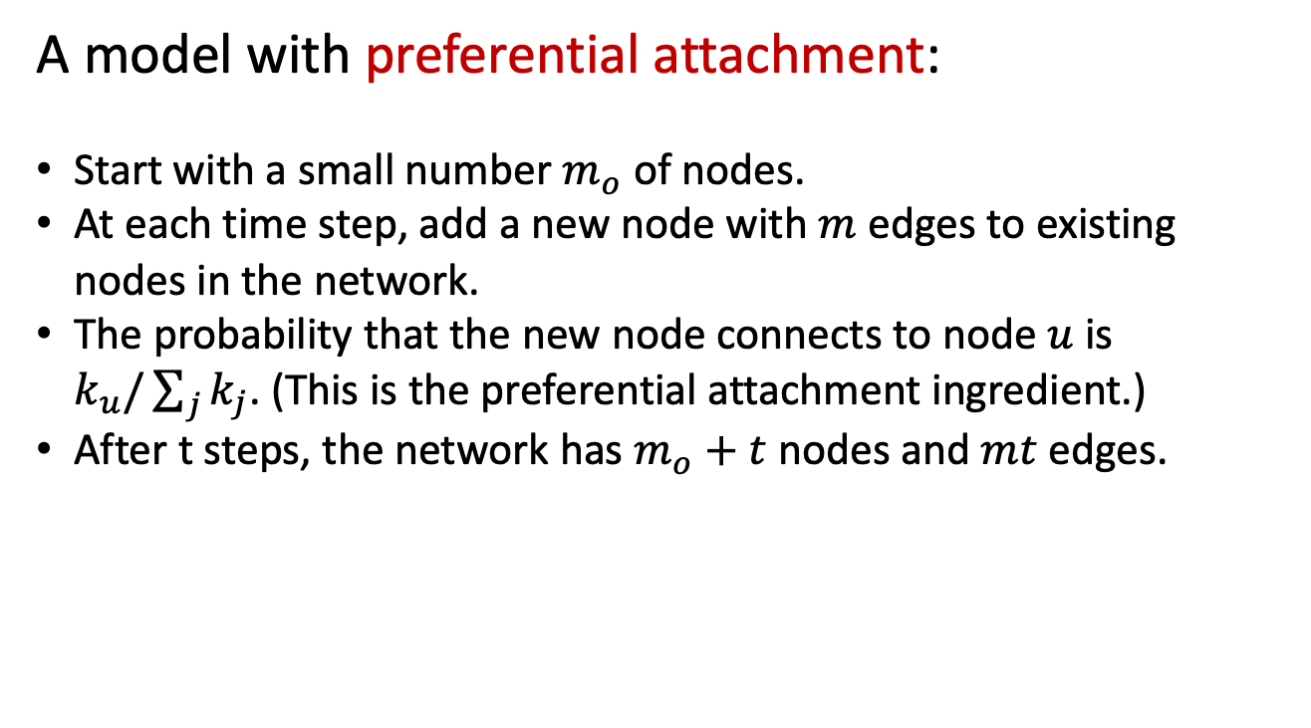
Barabási–Albert (scale-free) model
A model with preferential attachment:
Start with a small number $m_{o}$ of nodes.
At each time step, add a new node with $m$edges to existing nodes in the network.
The probability that the new node connects to node $u$ is $k_{u}/\sum_{j}{k_{j}}$. (This is the preferential attachment ingredient.)
After t steps, the network has $m_{o}+t$ nodes and $mt$edges.

Slide 31
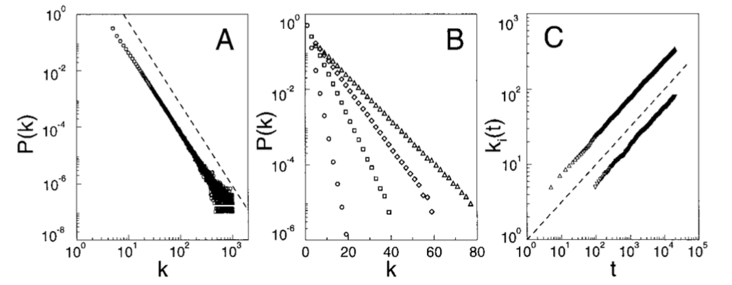
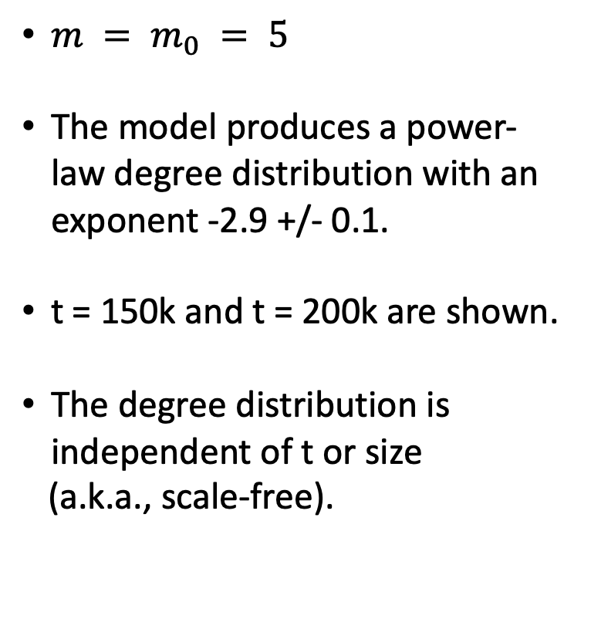
Simulations of the BA model
$m = m_{0} = 5$
The model produces a power-law degree distribution with an exponent -2.9 +/- 0.1.
t = 150k and t = 200k are shown.
The degree distribution is independent of t or size
(a.k.a., scale-free).
Barabási and Albert. Science, 1999.

Slide 32
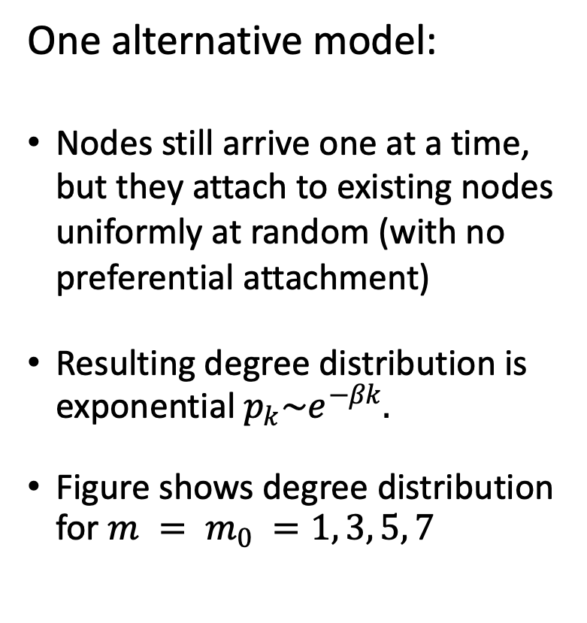
Preferential attachment is the key
One alternative model:
Nodes still arrive one at a time, but they attach to existing nodes uniformly at random (with no preferential attachment)
Resulting degree distribution is exponential $p_{k}\sim e^{−βk}.$
Figure shows degree distribution for $m = m_{0} =1, 3, 5, 7$

Slide 33
More hubs in scale-free networks
This simple model can reproduce the power-law degree distribution, where a few nodes (hubs) have a disproportionately high number of connections, while most have few.
Limitations of the BA model?
Notes:
The scale-free model primarily focuses on degree distribution, ignoring other key characteristics of real social networks, such as high clustering coefficients (small-world properties) and modularity.

Slide 34
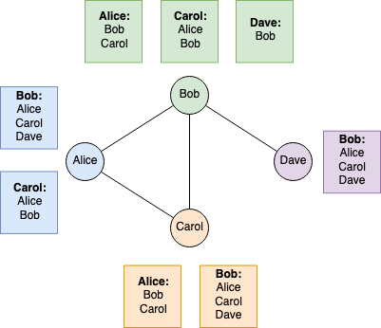
Friendship paradox
The phenomenon that an individual's friends have, on average, more friends than that individual has.
Notes:
k = (2+3+1+2) / 4 = 2
Friends’ k = (3+2+2+2+1+3+2+3) / 8 = 2.25

Slide 35
Finding hubs and influentials
Which nodes are the most important?
Suppose you are going to give away free tickets to your show
Who should you give them too?
Suppose you can pay someone to TikTok about your product
Who should you pay?
Suppose you want to be elected to a position
Whose endorsement will help you the most?
Notes:
Maybe because viral information is initially started by important nodes in the network.

Slide 36
Measures of node centrality
Degree centrality
PageRank centrality
Betweenness centrality
Closeness centrality
Eigenvector centrality
…
Which is best depends on the problem you are studying.
Notes:
To identify influentials

Slide 37
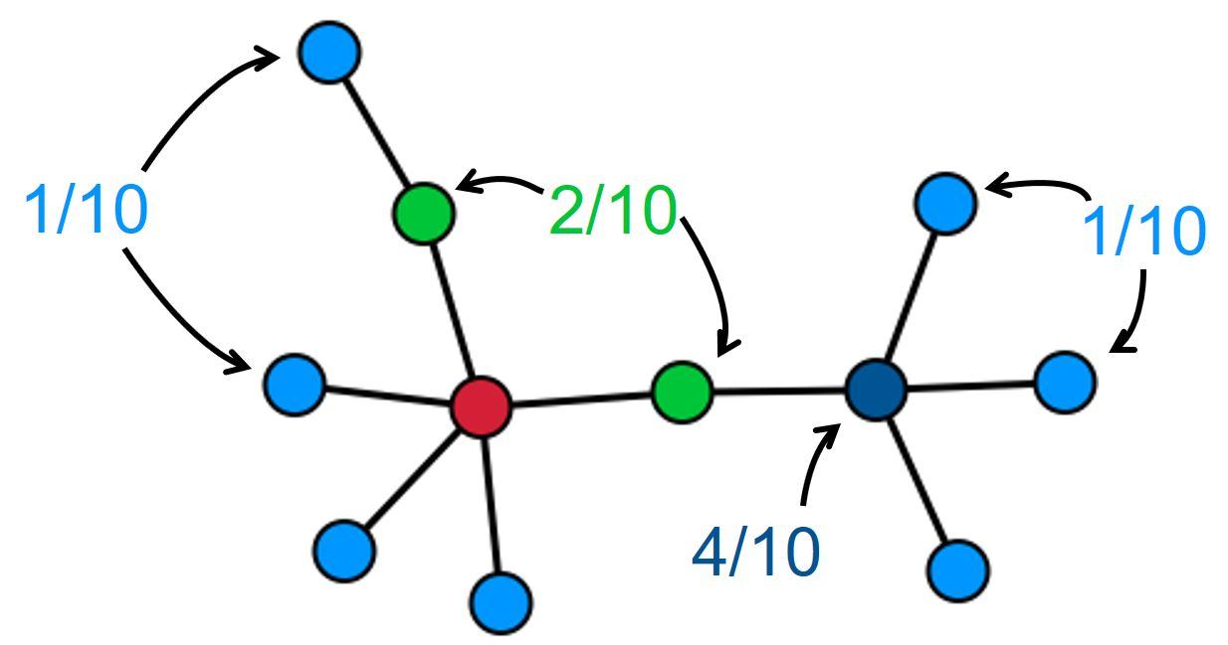
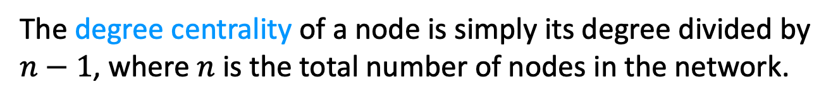
Degree centrality
The degree centrality of a node is simply its degree divided by $n−1$, where $n$ is the total number of nodes in the network.
When would this be a good measure of influence?
When/why might it not be a good measure of influence?
Notes:
For popularity
For scientific impact (citation): hard to rank papers with the same citation count. A citation from Nature may be more important than others.

Slide 38
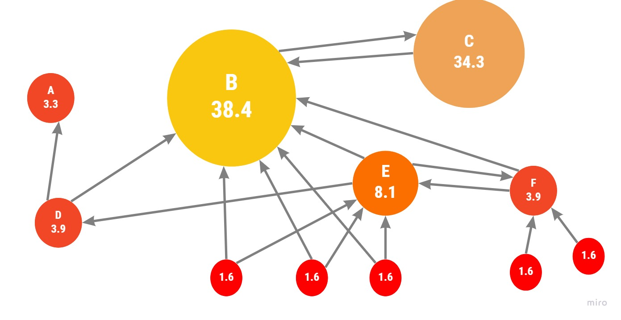
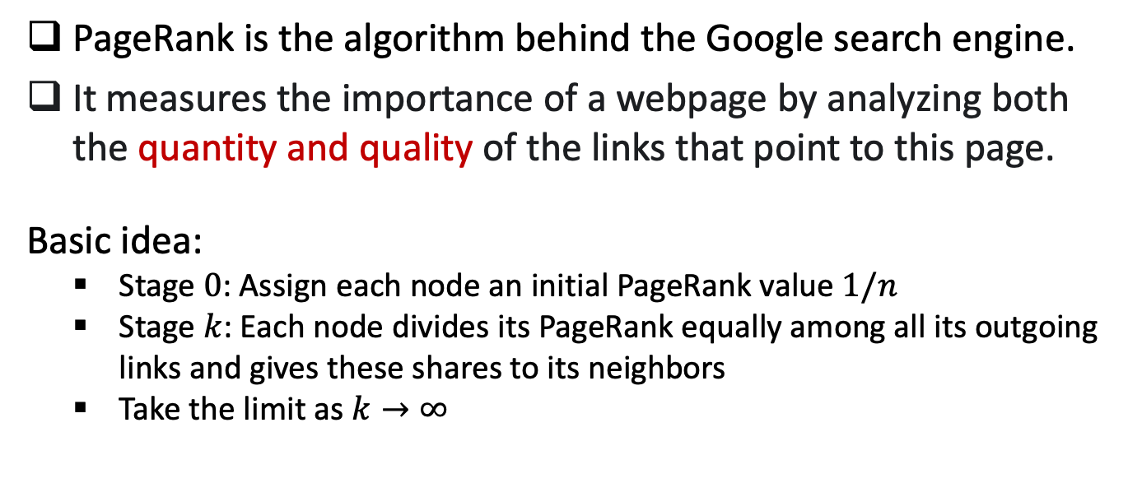
PageRank algorithm
PageRank is the algorithm behind the Google search engine.
It measures the importance of a webpage by analyzing both the quantity and quality of the links that point to this page.
Basic idea:
Stage $0$: Assign each node an initial PageRank value $1/n$
Stage $k$: Each node divides its PageRank equally among all its outgoing links and gives these shares to its neighbors
Take the limit as $k→∞$

Slide 39
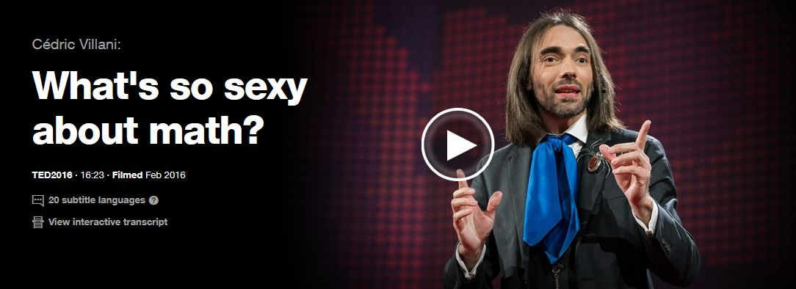
PageRank algorithm
https://www.ted.com/talks/cedric_villani_what_s_so_sexy_about_math
Watch video starting at minute 6:50

Slide 40
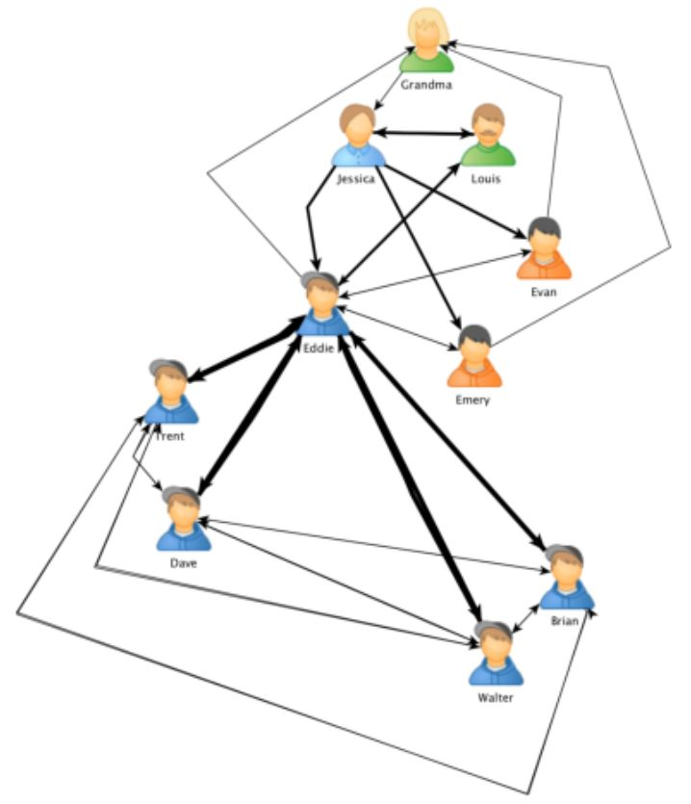
Betweenness centrality
The betweenness centrality of a node is calculated as the number of shortest paths of all pairs of nodes that pass through that node. It can measure the importance of nodes connecting different communities.
Notes:
Computation is very costly;
Nodes with high betweenness centrality scores are often called “broker”;
Broker plays a crucial role in exchanging information between communities;
Fig: Zaki Mohamed Hussain

Slide 41
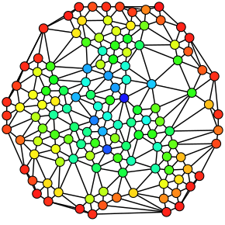
Betweenness centrality
Sometimes called “structural hole”, “bridge”.
Can be used to reflect power, social capital.
Real networks are vulnerable to attacks on brokers and hubs.
Fig: A directed graph colored based on the betweenness centrality of each node from least (red) to greatest (blue).

Slide 42
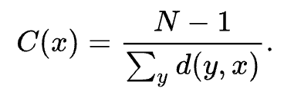
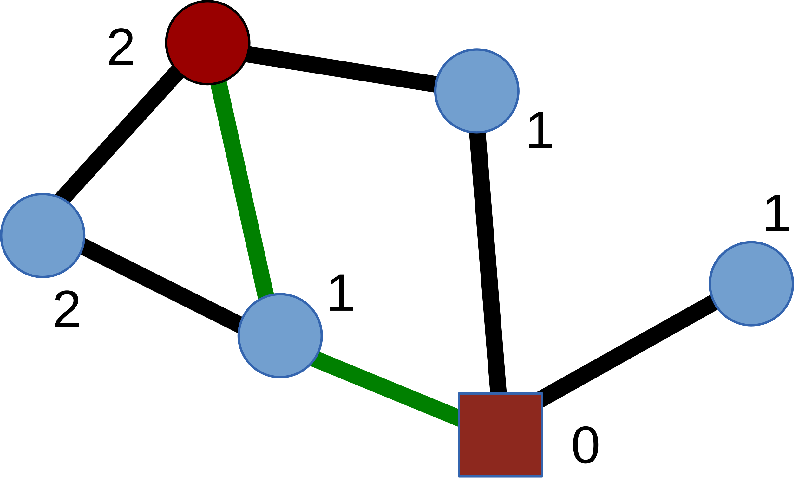
Closeness centrality
The closeness centrality of a node is calculated as the inverse of its avg shortest distance between the node and all other nodes in the network. The more central a node is, the closer it is to all other nodes.
The green edges illustrate one of the two shortest paths between the red square node and the red circle node.
Closeness of the square node: 5/(1+1+1+2+2) = 5/7

Slide 43
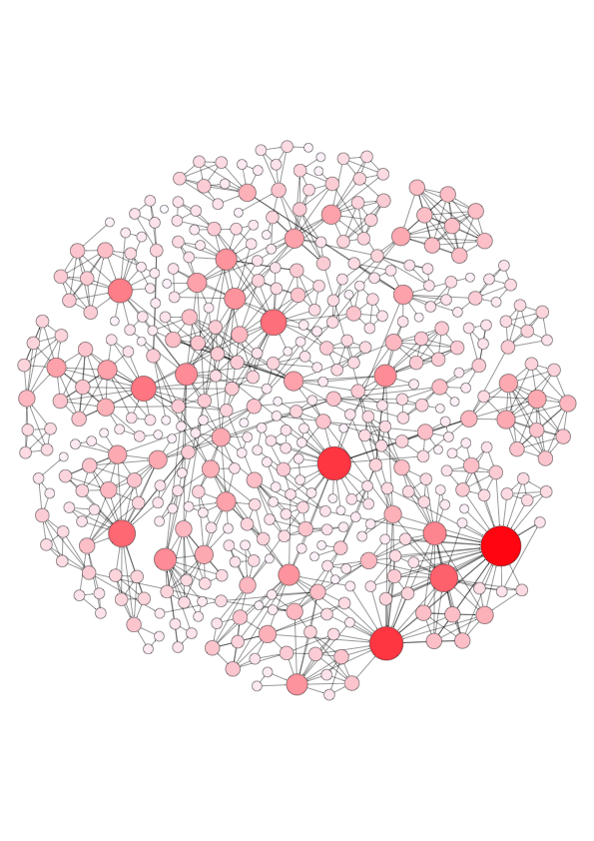
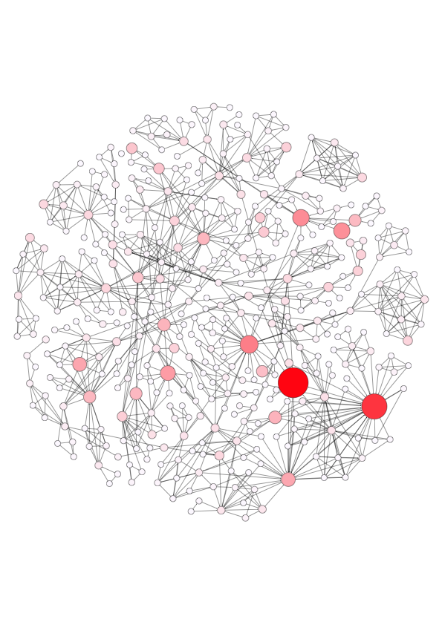
Comparing different measures
Degree centrality
PageRank
In what social scenarios should we use degree centrality?
What about the PageRank centrality? Give real examples.
Notes:
Important nodes identified by PR are quite different from that identified by DC.

Slide 44
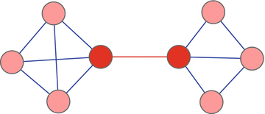
Edge betweenness centrality
Betweenness centrality of an edge is the number of all-pairs shortest paths that pass through the edge.
Notes:
To identify influentials

Slide 45
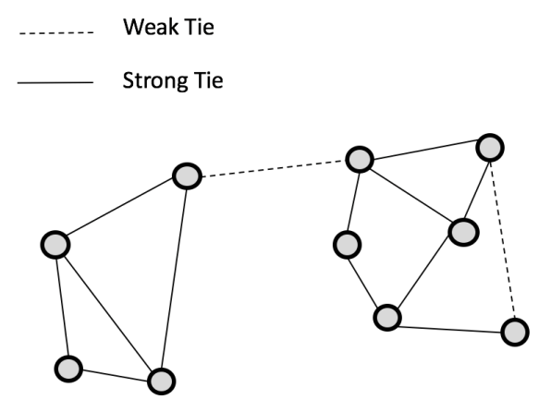
Strong ties and weak ties
Measured by edge weights such as the contact frequency, the number of mutual friends, instead of structural positions.
Weak ties often have high betweenness centrality.
Strong ties are often within communities; weak ties often connect communities.

Slide 46

Quick survey
How did you hear about our program?
Who will you reach out for finding a good job?
Who provide the opportunities in both scenarios?
Family members
Close friends
Acquaintance
Someone you don’t really know

Slide 47


Strength of weak tie (classic theory)
The idea that people often land jobs via weak connections.
One of the most (missed) influential ideas in social sciences.
https://www.jstor.org/stable/2776392
https://www.youtube.com/watch?v=g3bBajcR5fE

Slide 48



Evidence (observational) on Facebook

Slide 49

Replicated by LinkedIn experiment
A “delayed” causal test of this paradoxical theory;
Largest randomized experiments conducted on LinkedIn’s “People You May Know” algorithm;
The weakest ties had the greatest impact on job mobility, whereas the strongest ties had the least.

Slide 50

Link prediction
Given a network snapshot, the task is to predict new links among all nodes that are likely to occur in the future.
Often use topological features to measure node proximity:
Network distance
Common neighbors
Jaccard’s coeﬃcient: score(x, y) = |Γ(x) ∩ Γ(y)|/|Γ(x) ∪ Γ(y)|
Adamic and Adar score:
And more ...
Can also include node-level characteristics:
Gender, age, political orientation
Activity level, language use, profile image, …
Nowell and Kleinberg. “The Link-Prediction Problem for Social Networks.” CIKM 2003.
Notes:
Disciplinary and interdisciplinary relationships

Slide 51
Course notes
HW2 due today!
HW3 released
Due on Nov 28.
Social network v2 next week
Data visualization next week

Slide 52

LOQ course evaluation survey
Appreciate your insightful feedback!
LOQ system: https://onlinesurvey.cityu.edu.hk/
Also available on Canvas course site.
Notes:
Important nodes identified by PR are quite different from that identified by DC.

